Slide 1
Week-1
https://sites.google.com/site/drmohammadshahidulislam
Instructor: D.MSI

Slide 2
Computer Networks 1.5 hours in a week, 3.00 Cr.
Dr. Mohammad Shahidul Islam
Associate Professor

Slide 3
Reference Book(s):
1. Computer Networks - Andrew S. Tanenbaum
2. Computer Networks: Protocols, Standards, and Interfaces - Uyless Black
3. Internetworking with TCP/IP: Principles, Protocols, Architecture - D. E. Comer
4. TCP/IP Illustrated Vol. I - W. R. Stevens

Slide 4
Course Contents:
Protocol hierarchies; Data link control: HDLC;
DLL in Internet; DLL of ATM; LAN Protocols: Standards IEEE 802;
Hubs, Bridges, and Switches, FDDI,
Fast Ethernet; Routing Algorithm;
Internetworking, WAN; Fragmentation; Firewalls;
IPV4, IPV6, ARP, RARP, Mobile IP,
Network layer of ATM;
Transport Protocols; Transmission Control Protocol: Connection Management,

Slide 5
Course Contents:
Transmission Policy, Congestion Control, Timer Management;
UDP; AAL of ATM; wireless networks,
mobile computing, and high speed networks;
Gigabit Ethernet; Domain Name System: Name servers;
Email and Its privacy; SNMP; HTTP;
World Wide Web; Network security: Cryptography,
DES, IDEA, public key algorithm;
Authentication; Digital signatures.

Slide 6
Today
Computer Network basics
Protocol hierarchies;
Data link control: HDLC;

Slide 7
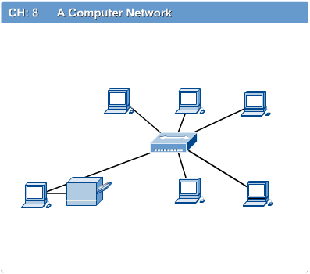
Computer Networks
Introduction to Computer Networks
Define?
Computer network connects two or more autonomous computers.
The computers can be geographically located anywhere.

Slide 8
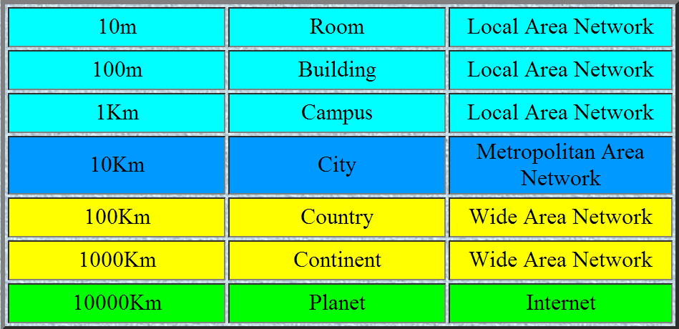
LAN, MAN & WAN
Introduction to Computer Networks
Network in small geographical Area (Room, Building or a Campus) is called LAN (Local Area Network)
Network in a City is call MAN (Metropolitan Area Network)
Network spread geographically (Country or across Globe) is called WAN (Wide Area Network)

Slide 9
Applications of Networks
Introduction to Computer Networks
Resource Sharing
Hardware (computing resources, disks, printers)
Software (application software)
Information Sharing
Easy accessibility from anywhere (files, databases)
Search Capability (WWW)
Communication
Email
Message broadcast
Remote computing
Distributed processing (GRID Computing)

Slide 10
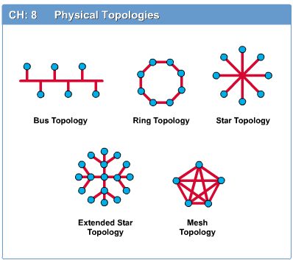
Network Topology BSRM
Introduction to Computer Networks
The network topology defines the way in which computers, printers, and other devices are connected.
A network topology describes the layout of the wire and devices as well as the paths used by data transmissions.

Slide 11
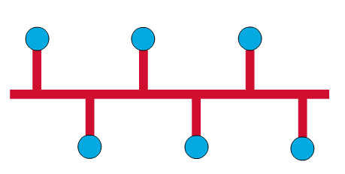
Bus Topology
Commonly referred to as a linear bus, all the devices on a bus topology are connected by one single cable.

Slide 12
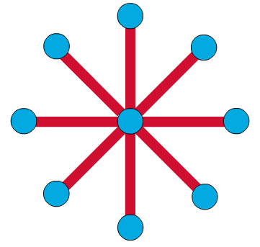
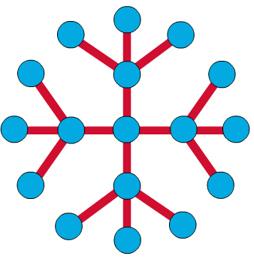

Star & Tree Topology
Introduction to Computer Networks
The star topology is the most commonly used architecture in Ethernet LANs.
When installed, the star topology resembles spokes in a bicycle wheel.
Larger networks use the extended star topology also called tree topology. When used with network devices that filter frames or packets, like bridges, switches, and routers, this topology significantly reduces the traffic on the wires by sending packets only to the wires of the destination host.

Slide 13
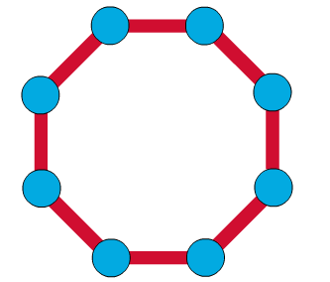
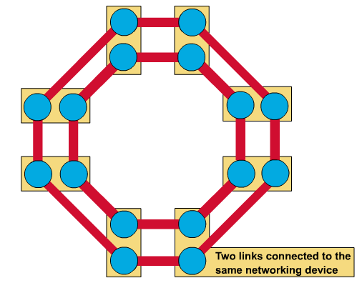
Ring Topology
Introduction to Computer Networks
A frame travels around the ring, stopping at each node. If a node wants to transmit data, it adds the data as well as the destination address to the frame.
The frame then continues around the ring until it finds the destination node, which takes the data out of the frame.
Single ring – All the devices on the network share a single cable
Dual ring – The dual ring topology allows data to be sent in both directions.

Slide 14
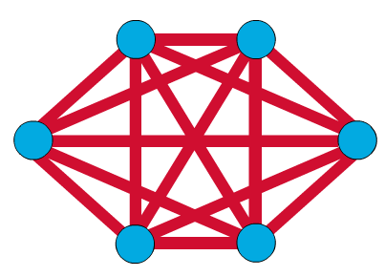
Mesh Topology
The mesh topology connects all devices (nodes) to each other for redundancy and fault tolerance.
It is used in WANs to interconnect LANs and for mission critical networks like those used by banks and financial institutions.
Implementing the mesh topology is expensive and difficult.

Slide 15
Network Components
Introduction to Computer Networks
Physical Media
Interconnecting Devices
Computers
Networking Software
Applications

Slide 16
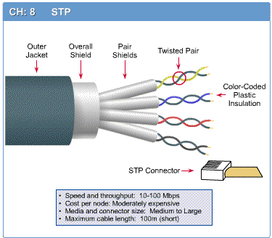
Networking Media
Introduction to Computer Networks
Networking media can be defined simply as the means by which signals (data) are sent from one computer to another (either by cable or wireless means).

Slide 17
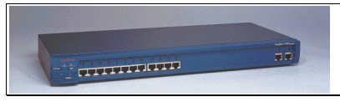
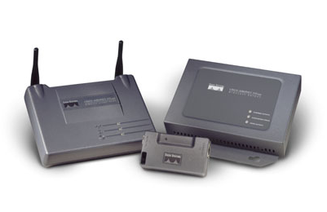
Networking Devices
Introduction to Computer Networks
HUB, Switches, Routers, Wireless Access Points, Modems etc.

Slide 18
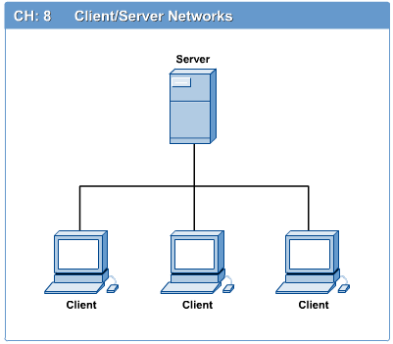
Computers: Clients and Servers
Introduction to Computer Networks
In a client/server network arrangement, network services are located in a dedicated computer whose only function is to respond to the requests of clients.
The server contains the file, print, application, security, and other services in a central computer that is continuously available to respond to client requests.

Slide 19
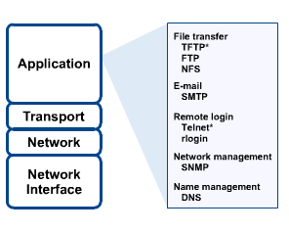
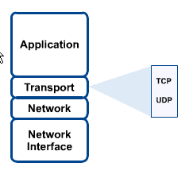
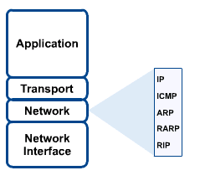
Networking Protocol: TCP/IP

Slide 20

Applications
Introduction to Computer Networks
E-mail
Searchable Data (Web Sites)
E-Commerce
News Groups
Internet Telephony (VoIP)
Video Conferencing
Chat Groups
Instant Messengers
Internet Radio

Slide 21
Protocol Hierarchies
• Most networks are organized as a series of layers or levels
– Each layer offers certain services to the higher layers
• Protocol
– an agreement between the communicating parties on how communication is to proceed.
– Layer n protocol

Slide 22
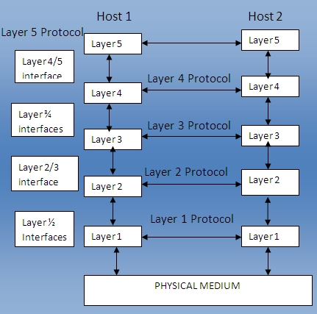
Fig: protocols, layers and interfaces

Slide 23
Peers and Interfaces
• Peers
– The entities comprising the corresponding layers on different machines
• Interface
– between each pair of adjacent layers
– defines which primitive operations and services the lower layer offers to the upper one.

Slide 24
Entities and Peer Entities
• An entity
– an active element in a layer
– can be a software entity (a process), a hardware entity (an I/O chip), or both (an I/O chip with its driver).
• Peer entities
– entities in the same layer on different machines

Slide 25
Protocol Stacks
• A protocol stack.
– A list of protocols used by a certain system, one protocol per layer
• Network architecture
– A set of layers and protocols

Slide 26
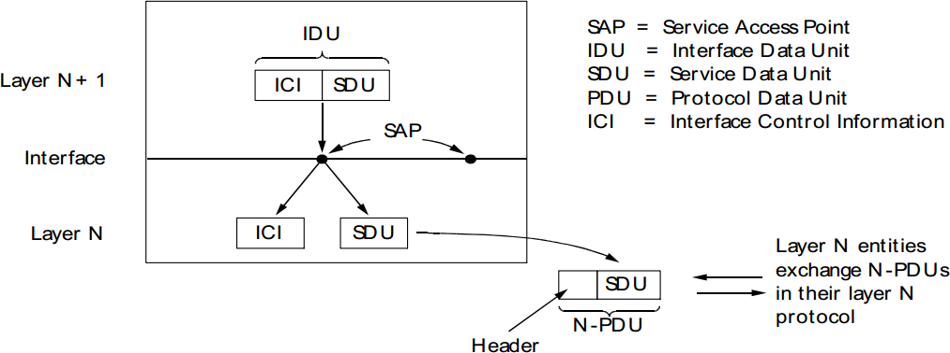
Layers at An Interface

Slide 27
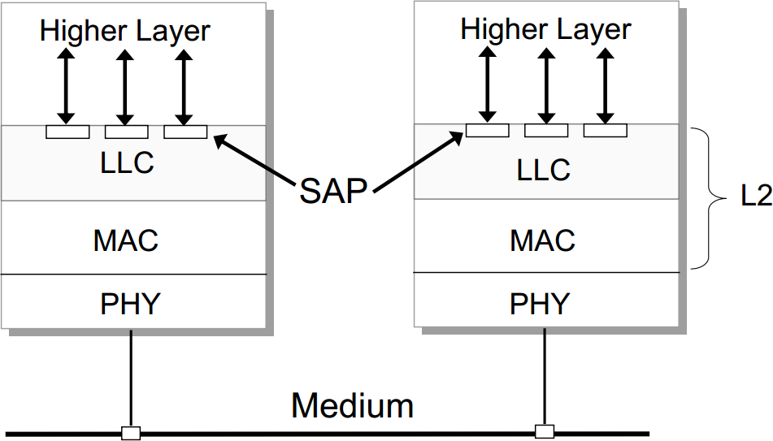
Example: SAPs in LLC

Slide 28
Till Now
LAN, MAN & WAN
Applications of Networks
Network Topology BSRM
Network Components PINCONA
:protocols, layers and interfaces
Peers, Entities and Peer Entities
Protocol Stacks
Layers at An Interface
Connections Multiplexing

Slide 29
Connections Multiplexing
Upward Multiplexing: Several layer N connections should be multiplexed into a
layer N-1 connection.
Downward Multiplexing: a layer N connection uses several layer N-1 connections.

Slide 30
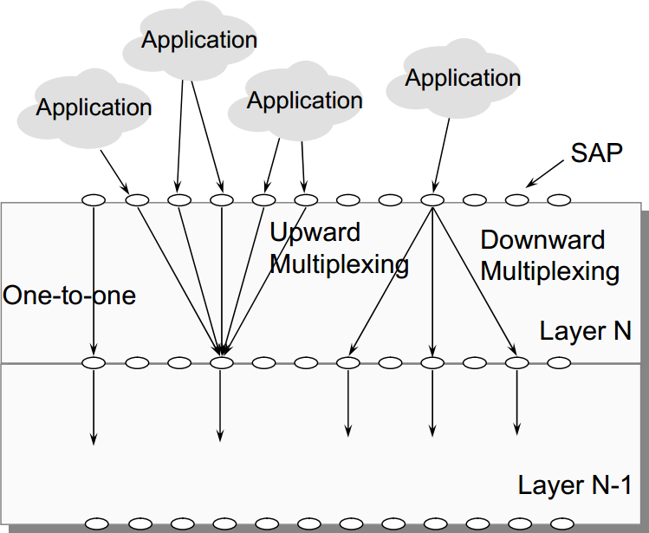
Connections Multiplexing[p-510-511]

Slide 31
Connection-Oriented and Connectionless Services
• connection-oriented
– Establish a connection first, use the
connection, and then release the connection.
– Example: the telephone system
• connectionless
– No connection is established.
– Example: the postal system

Slide 32
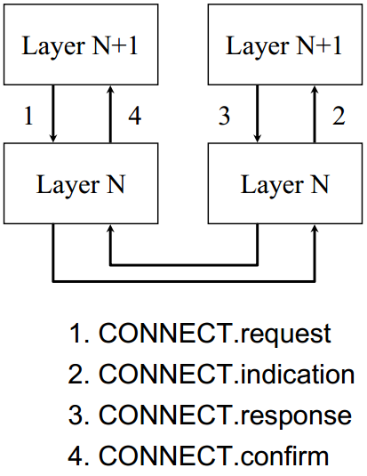
Service Primitives
• Request
– layer n+1 to layer n
• Indication
– layer n to layer n+1
– signal an event
• Response
– layer n+1 to layer n
– respond to the previous
indication
• Confirm
– layer n to layer n+1
– confirm the previous request

Slide 33
Reference Models
• The OSI Reference Model
– based on a proposal developed by the
International Standards Organization (ISO)
– a first step toward international
standardization of the protocols used in the
various layers.
• The TCP/IP Reference Model

Slide 34
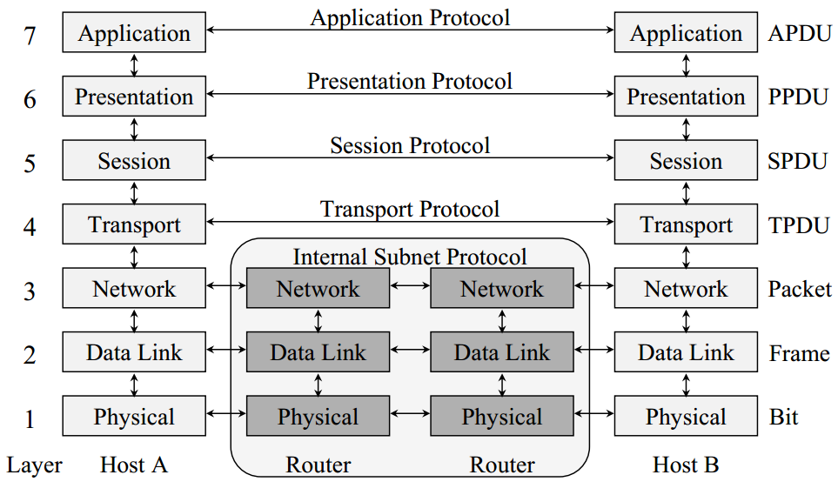
The OSI Reference Model

Slide 35
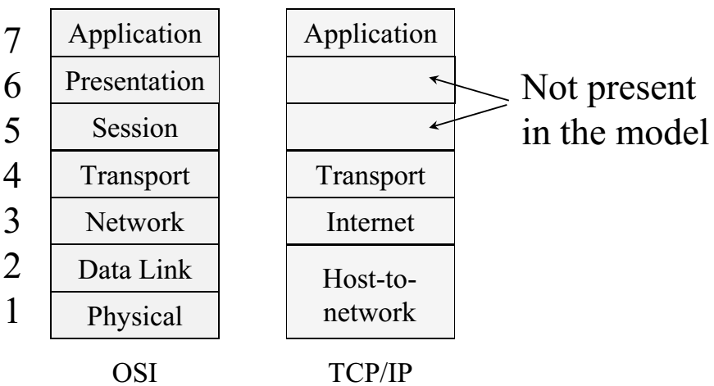
The TCP/IP Reference Model

Slide 36
Physical Layer
- main function to transmit bits over a communication channel
- to establish and terminate a connection to a communications medium
- responsible to make sure that when one side sends a '1' bit the other side will receive '1' bit and not '0' bit.

Slide 37
Data Link Layer
provides means to transfer data between network entities.
- it takes the bit streams of data from the Network Layer
- breaks into frames and passes them to the physical layer.
- At the receiving end data link layer detects and possibly corrects the errors
- passes the correct stream to the network layer.
- also concerned with flow control techniques.

Slide 38
Network Layer
- performs network routing,
- flow control
- error control functions.
- prevents the possibility of congestion .

Slide 39
Transport Layer
-main task to accept data from the Session layer,
- split them up into smaller units
- passes them to the Network layer
- make sure that all the pieces arrived correctly.
- checks the sequence of packets.

Slide 40
Session Layer
SS
responsible for controlling exchange information and
sets up, coordinates, and terminates conversations, exchanges, and dialogs between the applications at each end
synchronization.
Provides a session

Slide 41
Presentation Layer
PS
Responsible to translate different data formats from the representation used inside the computer (ASCII) to the network standard representation and back.
Computers use different codes for representing character strings so a standard encoding must be used and is handled by the presentation layer.
Generally in a few words this layer is concerned with the syntax and semantics of the information transmitted.

Slide 42
Application layer
Makes sure that the other party is identified and can be reached
If appropriate, authenticates either the message sender or receiver or both
Makes sure that necessary communication resources exist (for example, is there a modem in the sender's computer?)
Ensures agreement at both ends about error recovery procedures, data integrity, and privacy
Determines protocol and data syntax rules at the application level

Slide 43
Example Data Link Protocols
HDLC – High-Level Data Link Control
The Data Link Layer in the Internet

Slide 44
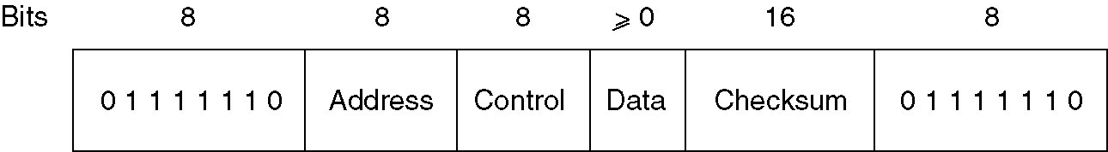
High-Level Data Link Control
All HDLC frames begin with the HDLC flag 01111110, which is byte stuffed if occurs in the rest of the frame.
The address field : on lines with multiple terminals, the address field is used to identify one of the terminals
The control field: used for sequence numbers, acknowledgements and other purposes.
The data field: may contain any information. It can have any length, although the efficiency of the checksum falls down with increasing frame length, due to the probability of occurrence of multiple burst errors.
CRC – checksum obtained with techniques………
End of frame (same as start of frame)
Frame format for bit-oriented protocols
Notes:
The frame begins with a frame sequence: 01111110
The address field : on lines with multiple terminals, the address field is used to identify one of the terminals
The control field: used for sequence numbers, acknowledgements and other purposes as shown on the next slide
The data field: may contain any information. It can have any length, although the efficiency of the checksum falls down with increasing frame length, due to the probability of occurrence of multiple burst errors.
The Checksum is the Cyclic Redundancy Code obtained with the technique described earlier
The frame is ended with another frame sequence: 01111110

Slide 45
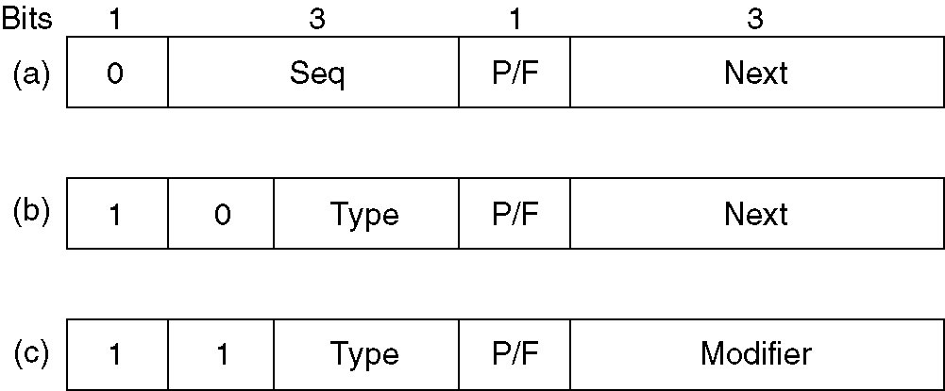
High-Level Data Link Control (2)
Control field of
(a) An information frame.
(b) A supervisory frame.
(c) An unnumbered frame.
Notes:
There are three types of frames: information, supervisory and unnumbered.

Slide 46
Information Frame
SEQ – 3 bits sequence numbers are used
NEXT – used for piggybacking acknowledge
All of the HDLC protocols adhere to the convention that instead of sending the sequence number for the frame that has been received correctly, the acknowledgement contains the sequence number of the next frame that is expected (not received yet).
Notes:
The protocol is using a sliding window with 3 bits sequence numbers. Up to 7 unacknowledged frames can be in the traffic at any time. The SEQ field is the frame sequence number, while the NEXT field is the piggyback acknowledgement.
All of the HDLC protocols adhere to the convention that instead of sending the sequence number for the frame that has been received correctly, the acknowledgement contains the sequence number of the next frame that is expected (not received yet).
The P/F bit stands for Pool/Final and it is used when a computer is polling a group of terminals. When used as P, the computer is inviting the terminals to send data. All the frames from the terminal, except the final one, have the P/F flag set to P. The final one is F. The F flag is sometimes used to force the other machine to send a supervisory frame immediately, without waiting for reverse traffic where to piggyback the window information.

Slide 47
Information Frame
The P/F bit stands for Pool/Final and it is used when a computer is polling a group of terminals.
When used as P, the computer is inviting the terminals to send data. All the frames from the terminal, except the final one, have the P/F flag set to P. The final one is F.
The F flag is sometimes used to force the other machine to send a supervisory frame immediately, without waiting for reverse traffic where to piggyback the window information.
Notes:
The protocol is using a sliding window with 3 bits sequence numbers. Up to 7 unacknowledged frames can be in the traffic at any time. The SEQ field is the frame sequence number, while the NEXT field is the piggyback acknowledgement.
All of the HDLC protocols adhere to the convention that instead of sending the sequence number for the frame that has been received correctly, the acknowledgement contains the sequence number of the next frame that is expected (not received yet).
The P/F bit stands for Pool/Final and it is used when a computer is polling a group of terminals. When used as P, the computer is inviting the terminals to send data. All the frames from the terminal, except the final one, have the P/F flag set to P. The final one is F. The F flag is sometimes used to force the other machine to send a supervisory frame immediately, without waiting for reverse traffic where to piggyback the window information.

Slide 48
Supervisory Frame
Various kinds of SUPERVISORY frames are distinguished by the type filed:
[00]Type 0 is an acknowledgement frame (called RECEIVE READY), used to indicate the next frame expected
[01]Type 1 is a negative acknowledgement frame (called REJECT), used to indicate an error. The NEXT field indicates the first frame in sequence that has not been received correctly. The sender is requested to send all frames beginning at NEXT
Notes:
Various kinds of SUPERVISORY frames are distinguished by the type filed:
Type 0 is an acknowledgement frame (called RECEIVE READY), used to indicate the next frame expected
Type 1 is a negative acknowledgement frame (called REJECT), used to indicate an error. The NEXT field indicates the first frame in sequence that has not been received correctly. The sender is requested to send all frames beginning at NEXT
Type 2 is RECEIVE NOT READY. It acknowledges all frames up to but not including the NEXT one. It also tells the sender to stop sending. When the receiver is ready again, it sends a RECEIVE READY.
Type 3 is a SELECTIVE REJECT. It calls for retransmission of only the frame specified. Thus, if a receiver wants to buffer out of sequence frames, it can force the retransmission of a specific frame by using a selective reject.

Slide 49
Supervisory Frame
[10]Type 2 is RECEIVE NOT READY. It acknowledges all frames up to but not including the NEXT one. It also tells the sender to stop sending. When the receiver is ready again, it sends a RECEIVE READY.
[11]Type 3 is a SELECTIVE REJECT. It calls for retransmission of only the frame specified. Thus, if a receiver wants to buffer out of sequence frames, it can force the retransmission of a specific frame by using a selective reject.

Slide 50
Unnumbered Frame
UNNUMBERED FRAME is used for control and to carry data when unreliable connectionless service is required.
Using this frame, a number of commands can be sent:
DISConect – allows a machine to announce its intention to bring down the connection
SABM (Set Asynchronous Balanced Mode) – resets the line
FRMR (Frame Reject) – indicates that a frame with correct checksum but incorrect semantics has arrived
More control frames are actually available for initialization, polling and status reporting.

